Slide 1
BLACK WIDOW OPTIMIZATION ALGORITHM

Slide 2
The Algorithm
The algorithm for Black Widow Optimization Algorithm is:
1. Generate a random population of spiders.
2. Choose a male and female spider. Mate them and destroy the male spider.
3. Generate two children spiders from the mating process. The better child may cannibalize the other child or the mother depending upon the cannibalism rate.
4. From the remaining spiders, randomly mutate one of the spiders depending upon the mutation rate.
5. Continue the process for a specified number of iterations. At the end, the spider with the best fitness is the solution to the optimization problem.

Slide 3

Installing BWO Library in Python

Slide 4

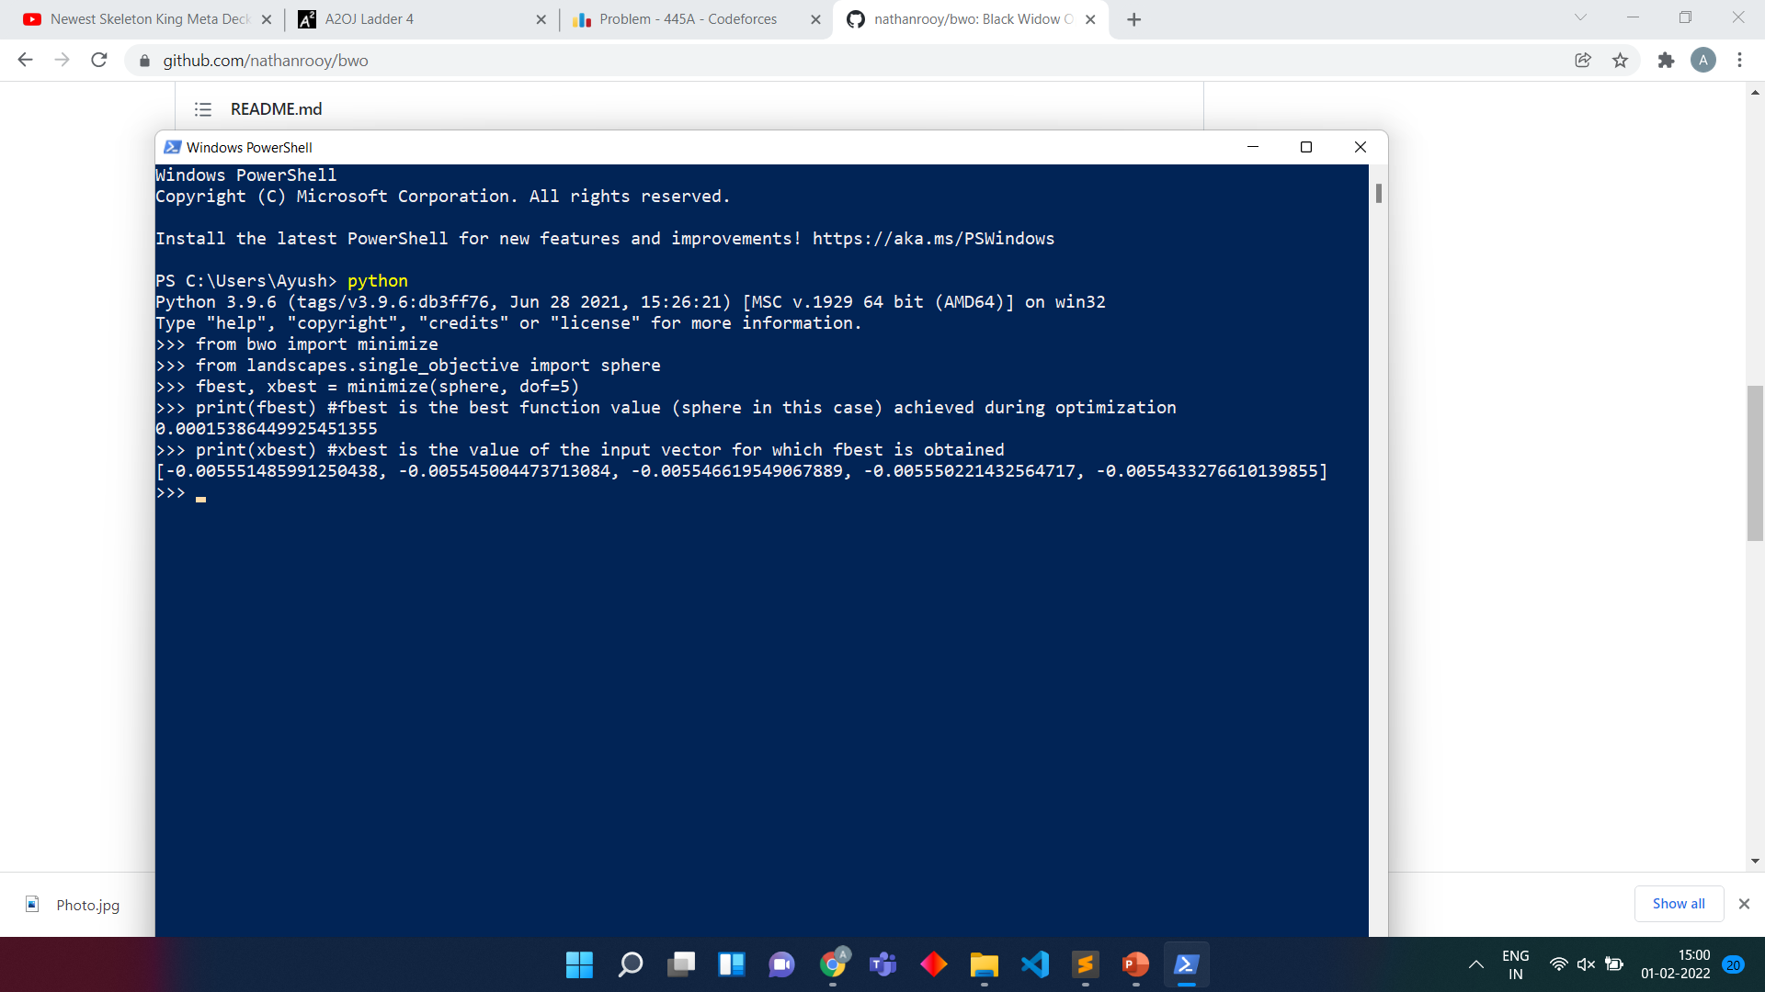

BWO Algorithm in Python
The sphere function is:
where d is the number of dimensions (here, degree of freedom (dof) ) and each x_{i} ∈ [-5.12, 5.12], for all i = 1, …, d.
Its local minimum occurs when each x_{i} = 0.
As we can see from the screenshot, the answer given by the BWO is very close to the answer and was given almost instantaneously.
We can also explicitly specify the boundary conditions using bounds, which is a list of tuples of the form (min, max) and maximum iterations using maxiter = N.

Slide 5
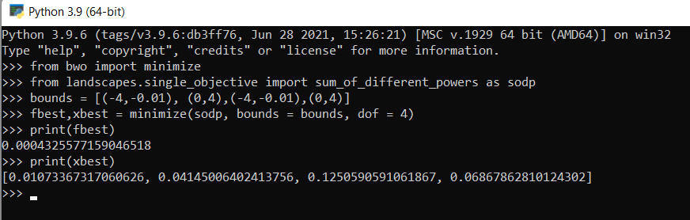
The sum_of_different_powers function is defined as:
∑_{i = 1} ^{N} | x_{i}| ^{i+1}
where x_{i} is inside some range.
The function is minimized when each x_{i} = 0.
As can be seen, the BWO comes really close to finding the global minima in a very short time.

